Slide 1
ML Metadata Store
Pravin Y Pawar
Adapted from
ML Metadata Store: What It Is, Why It Matters, and How to Implement It
by Jakub Czakon

Slide 2
Need for metadata
But the problems people have with storing and managing ML model metadata are different.
For some, it is messy experimentation that is the issue
Others have already deployed the first models to production, but they don’t know how those models were created or which data was used
Some people already have many models in production, but
orchestrating model A/B testing,
switching challengers and champions,
or triggering, testing, and monitoring re-training pipelines is not great.
ML metadata store can help with all of those things and then some others as well.

Slide 3
What is ML metadata anyway?
When you do machine learning, there is always a model involved. It is just what machine learning is.
Ml Model could be a classic, supervised model like a lightGBM classifier, a reinforcement learning agent, a bayesian optimization algorithm, or anything else really.
But it will take some data, run it through some numbers and output a decision.
… and it takes a lot of work to deliver it into production.
One has to:
train,
tune,
debug,
evaluate,
explain,
and compare it to baseline.
If model makes it past the research phase, it also has to :
package,
deploy,
monitor,
and re-train it.

Slide 4
What is ML metadata anyway? (2)
A lot of steps!
Don’t go through those steps linearly, and you don’t go through them once.
Takes a lot of iterations of fixing data, fixing model, fixing preprocessing, and all that good stuff.
Each of those steps produces meta-information about the model, or as many people call it, ML model metadata.
Those could be:
training parameters,
evaluation metrics,
prediction examples,
dataset versions,
testing pipeline outputs,
references to model weights files,
and other model-related things.
This information helps you know your models.
Where the particular version of the model is and quickly rollback to the previous version
How the model was built and who created it
Which data/parameters/code it used at training
How does the new experiment or model version compare to the baseline or previous production models
How did it perform at various evaluation stages
And when your models are important to someone, when they touch users or help clients make decisions, you better know a
lot about them.

Slide 5
Metadata about experiments and model training runs
During experimentation, you usually care about debugging, visualizing, monitoring your model training to get to the best model.
To do that, it is a good practice to log anything that happens during the ML run, including:
data version: reference to the dataset, md5 hash, dataset sample to know which data was used to train the model
environment configuration: requirements.txt, conda.yml, Dockerfile, Makefile to know how to recreate the
environment where the model was trained
code version: git SHA of a commit or an actual snapshot of code to know what code was used to build a model
hyperparameters: configuration of the feature preprocessing steps of the pipeline, model training, and inference to
reproduce the process if needed
training metrics and losses: both single values and learning curves to see whether it makes sense to continue training
record of hardware metrics: CPU, GPU, TPU, Memory to see how much your model consumes during
training/inference
evaluation and test metrics: f2, acc, roc on test and validation set to know how your model performs
performance visualizations: ROC curve, Confusion matrix, PR curve to understand the errors deeply
model predictions: to see the actual predictions and understand model performance beyond metrics
…and about a million other things that are specific to your domain

Slide 6
Metadata about artifcats
Apart from experiments and model training runs, there is one more concept used in ML projects: artifact
input or output of those runs can be used in many runs across the project
Artifacts can change during the project, and typically have many versions of the same artifact at some point in your ML lifecycle
Artifacts could be datasets, models, predictions, and other file-like objects.
For artifacts you may want to log:
Reference: Paths to the dataset or model (s3 bucket, filesystem)
Version: Dataset or model md5 hash to let you quickly see the diff
Preview: Dataset/prediction preview (head of the table, snapshot of the image folder) to see what this dataset is about
Description: additional info about the artifact that will help you understand what it is. For example, you may want to log column names for a tabular dataset artifact
Authors: who created modified this artifact and when
And many other things that may be specific to your project as the size of the dataset, type of the ML model and others

Slide 7
Metadata about trained models
Trained models are such an important type of artifact in ML projects
Once your model is trained and ready for production, needs change from debugging and visualization to knowing how to deploy a model package, version it, and monitor the performance on prod.
So the ML metadata may want to log are:
Model package: Model binary or location to your model asset
Model version: code, dataset, hyperparameters, environment versions
Evaluation records: History record of all the evaluations on test/validation that happened over time
Experiment versions: Links to recorded model training (and re-training) runs and other experiments associated with this model version
Model creator/maintainer: who build this model, and who should you ask if/when things go wrong
Downstream datasets/artifacts: references of datasets, models, and other assets used downstream to build a model. This can be essential in some orgs for compliance.
Drift-related metrics: Data drift, concept drift, performance drift, for all the “live” production
Hardware monitoring: CPU/GPU/TPU/Memory that is consumed in production.
And anything else that will let you sleep at night while your model is sending predictions to the world

Slide 8
Metadata about pipeline
You may be at a point where your ML models are trained in a pipeline that is triggered automatically:
When the performance drops below certain thresholds
When new labeled data arrives in the database
When a feature branch is merged to develop
Or simply every week
Likely have some CI/CD workflow connected to a pipeline and orchestration tool like Airflow, Kubeflow, or Kedro
every trigger starts the execution of a computation DAG (directed acyclic graph) where every node produces metadata
Need for the metadata is a bit different than for experiments or models
This metadata is needed to compute the pipeline (DAG) efficiently:
Input and output steps: information about what goes into a node and what goes out from a node and whether all the
input steps are completed
Cached outputs: references to intermediate results from a pipeline so that you can resume calculations from a
certain point in the graph

Slide 9
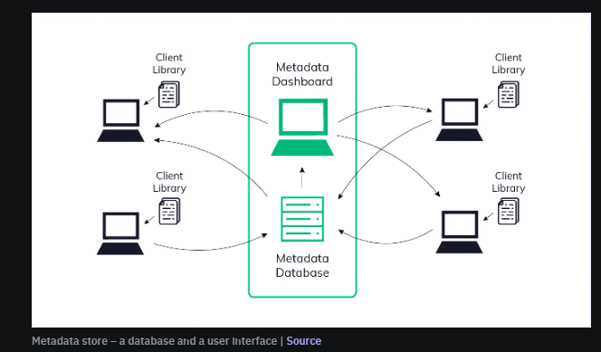
What is an ML metadata store?
ML metadata store is a “store” for ML model-related metadata
place where one can get anything one need when it comes to any and
every ML model you build and deploy.
More specifically, ML metadata store lets you:
log,
store,
display,
monitor,
compare,
organize,
filter,
and query all model-related metadata.
In short, it gives a single place to manage all the ML
metadata about experiments, artifacts, models, and pipelines
we have listed in the previous section.
You can think of it as a database and a user interface built
specifically to manage ML model metadata
It typically comes with an API or an SDK (client library) to
simplify logging and querying ML metadata.

Slide 10
Repository vs Registry vs Store
In the context of ML metadata,
all of those things are basically databases created to store metadata that have slight functional differences
A metadata repository
place where store metadata objects along with all the relationships between those objects
can use GitHub as a repository where save all the evaluation metrics as a file created via post-commit hook or log parameters and
losses during training to an experiment tracking tool which in this context is actually a repository
A metadata registry
place where you “checkpoint” the important metadata
register something you care about and want to easily find and access it later
A registry is always for something specific. There are no general registries
For example, you may have a model registry that lists all the production models with references to the ML metadata repository
where the actual model-related metadata is.
A metadata store
place where you go “shopping” for metadata
For ML models, it is a central place where you can find all the model, experiment, artifact, and pipeline-related metadata
The more you need to come to the “shop”, search metadata “products”, compare them and “buy” them, the more it is a store rather
than a repository.

Slide 11
Two flavors of ML metadata store
Pipeline-first vs model-first ML metadata store
As your ML organization matures, you get to a point when training models happen in some automated, orchestrated pipelines
At that moment, running experiments, training, and re-training productions models is always associated with executing a pipeline.
ML metadata store can:
Treat pipelines as first-class objects and associate resulting models and experiments with them
Treat models and experiments as first-class objects and treat pipelines as a mode of execution
Depending on what you put in a center, your ML metadata store will do slightly different things
If you focus on the process, the model building pipeline, you get something like MLMD, which powers pipeline and orchestration tools like Kubeflow and TensorFlow Extended (TFX).
If you focus on the output, the model, you get something like MLflow or Neptune.

Slide 12
How do you set up an ML metadata management system?
Build vs maintain vs buy
It’s an old dilemma!
People who work in software face it many times in their careers.
To make a decision, you should:
understand what problem you are actually solving
see if there are tools that can solve this problem before building it
assess how much time it will take to build, maintain, and customize it
don’t underestimate the amount of effort that goes into it

Slide 13
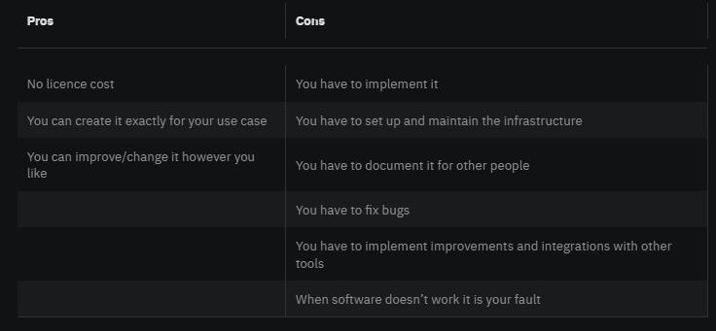
How do you set up an ML metadata management system?(2)
Build a system yourself

Slide 14
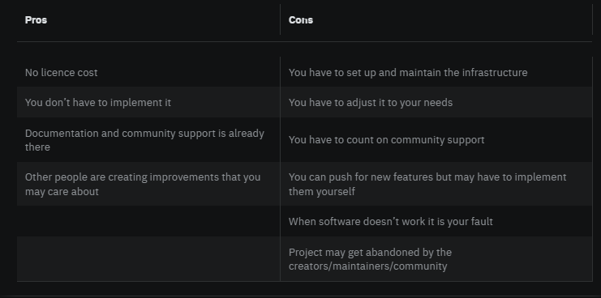
How do you set up an ML metadata management system?(3)
Maintain open source

Slide 15
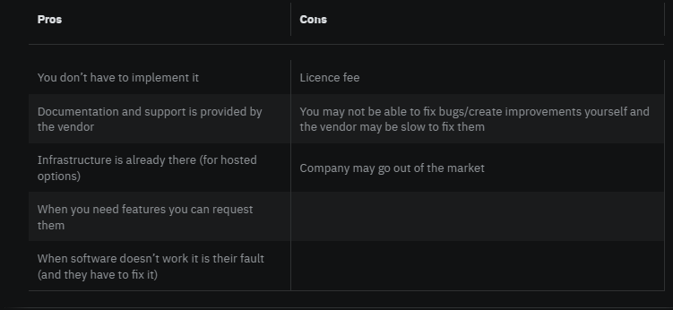
How do you set up an ML metadata management system?(4)
Buy a solution

Slide 16
Thank You!
In our next session:

